Slide 1

King County Housing
Real Estate marketing campaign
Data-Driven insights and predictive modeling

Slide 2

Problem Statement
Advertising campaign to promote sales in King County
Data-Driven Decisions
Model to predict House Prices
As an aspirant data scientist, I share the results of my project to promote an advertising campaign in King County real estate market.
we will provide recommendation to shape the campaign based on our regression model to predict the prices

Slide 3
Business Value
Generate revenue via successful marketing campaign
Better understand the preferences of buyers
Assist valuation team providing price predictions

Slide 4
Business Value
the business value of our project is to drive a successful advertising campaign which leads the generation of revenue, but also to provide a good service for the buyers.
this project also helps understand buyer preferences and provides guidance to the sales team.
finally, having a model capable of predicting house prices will help the valuation team by providing a good estimate

Slide 5
Methodology
Data analysis
Investigate features and gain insights
Find significant pattern and trends using statistical methods
Build prediction model
The dataset used in our project consists of 21,597 house sales prices for the period between 1900 and 2015.
the investigative part of our analysis is to find valuable features that provide interesting insights to promote our campaign.
finally we build a model capable to predict house prices.

Slide 6
House Features
Analysing houses features to determine which factor drive the price up and which factor are doing best predictor price

Slide 7
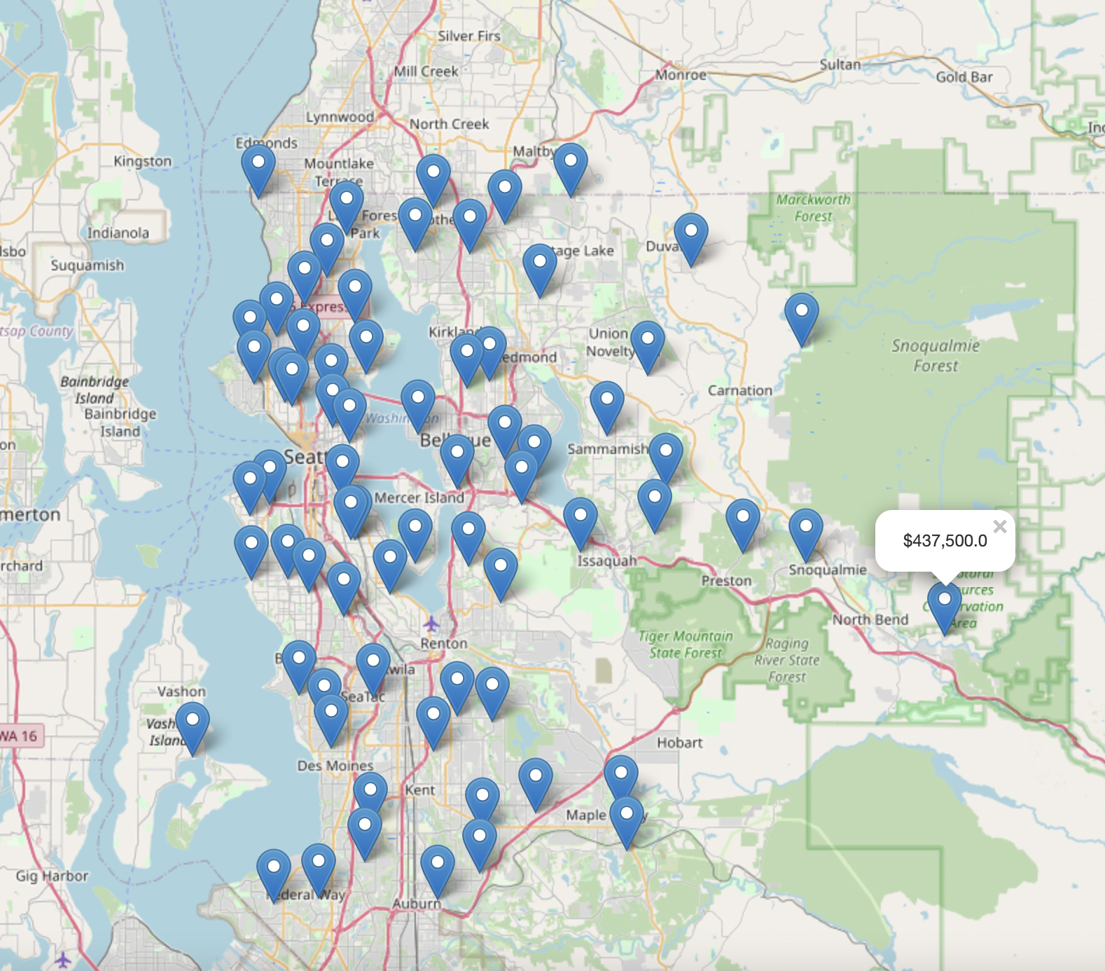
Location
the first key feature we explore is location. We want to understand which areas have the highest house prices and how much house prices are affected, this is an important key on which we focus our campaign.
as zoomed on the interactive plot shows the 70th unique zip codes which represent the sales of 24 cities between 2014-2015.

Slide 8
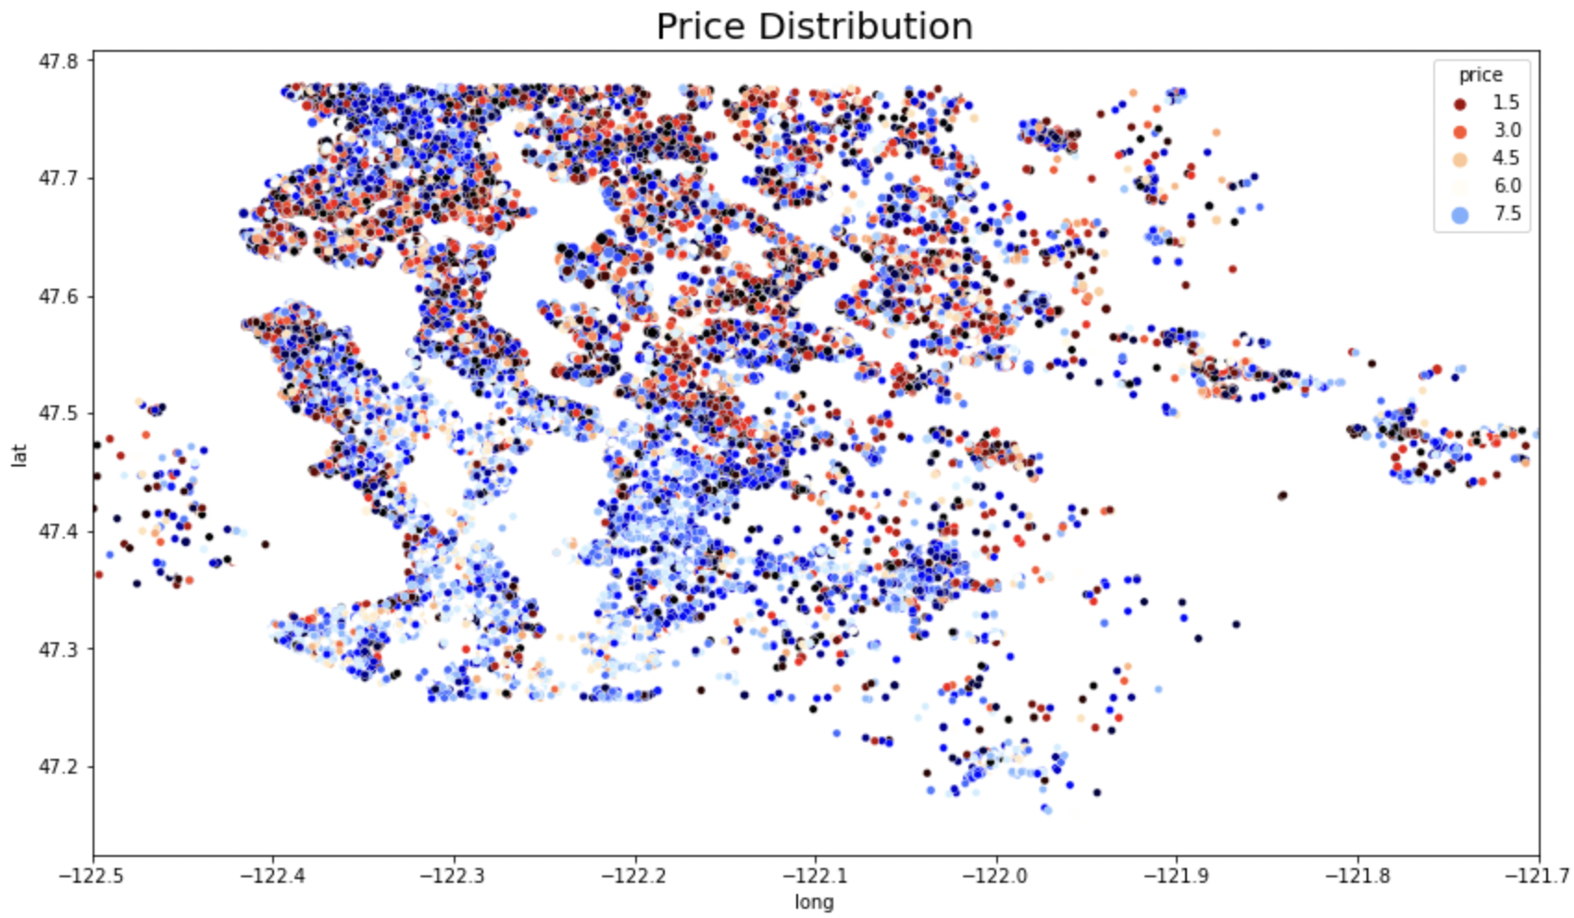
Price projection based on longitude and latitude

Slide 9
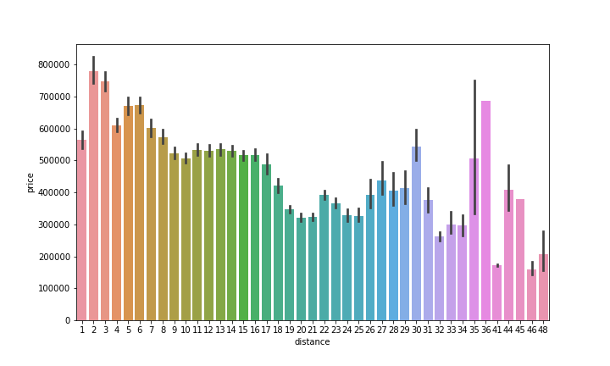
Distance & nearby Features vs. Price
the distance factor can influence why some neighborhoods require high prices and others that are a few miles away do not. Additionally, a location's proximity to highways, utility lines, and public transport can affect the overall value of a home

Slide 10
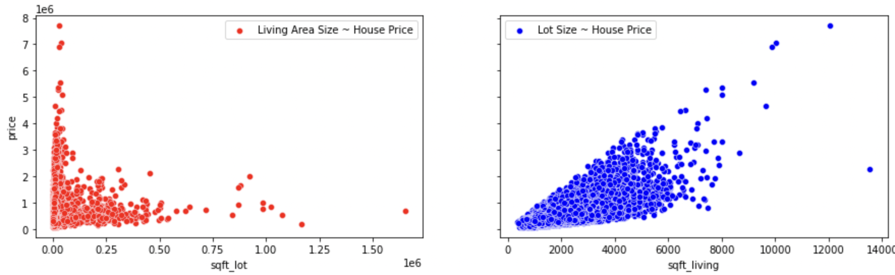
Living aera & Lot size vs. Price
one of the most important features that positively affects the house prices is the square foot lot and living area, we would expect large house to be expensive.

Slide 11
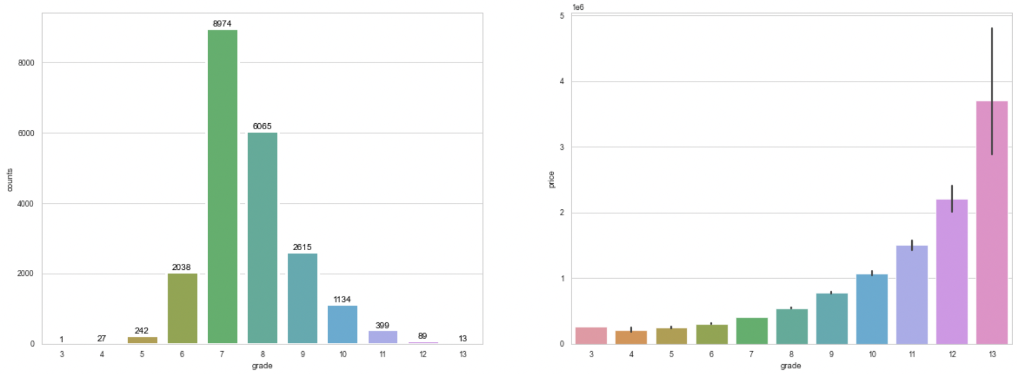
Grade vs. Price
Construction grade which range from 1 to 13 is important features with high correlation for our campaign we would recommend houses with grade 9 or above. this would have a median price above $700,000.

Slide 12
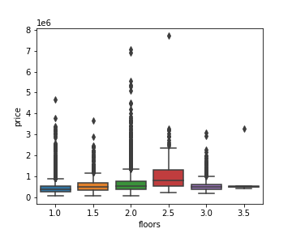
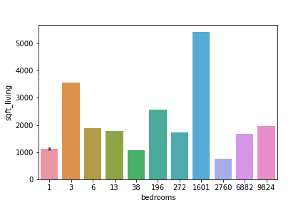
Floors & Bedrooms vs. Price

Slide 13
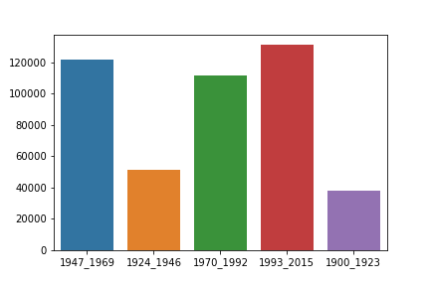
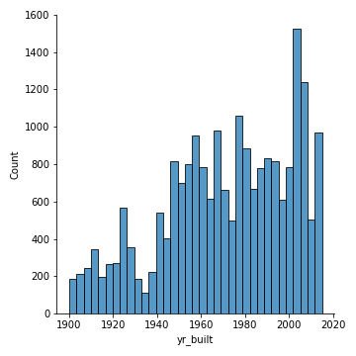
Year Built vs. Price

Slide 14
Predicting House Prices
 | Model A | Model B
Features | 5 | 65
Pros. | Simple interpretation | Performance
Cons. | Less accurate | Categorical Features
Score | 0.626 | 0.80
Mean Error | $ 224,726.54 | $ 157,457.27

Slide 15
Conclusion
choose location wisely
Maximize interior square footage
High grade
High condition

